Slide 1

VOLUME 2
MODULE 4
GRADE 5-6
SESSION 2- Why is listening Important

Slide 2


CLASS ROOM RULES !
Participate by listening actively and paying attention.
Do not mass answer and wait for your turn.
Respect other people’s feelings and time.
Implement the SOCH learning.
Accept feedback and make necessary changes for self .

Slide 3




Walk ,Stop , Jump , Dance Clap, Name
https://www.youtube.com/watch?v=oTpXlpxFoBI

Slide 4


Absent Mindedness and its Impact on Listening
• .

Slide 5

The Importance of Active-Mindedness in Listening

Slide 6



VIDEO TIME
https://youtu.be/6A-RqZzd2JU
https://youtu.be/6vTsyJZbkug
Notes:
https://youtu.be/6vTsyJZbkug

Slide 7
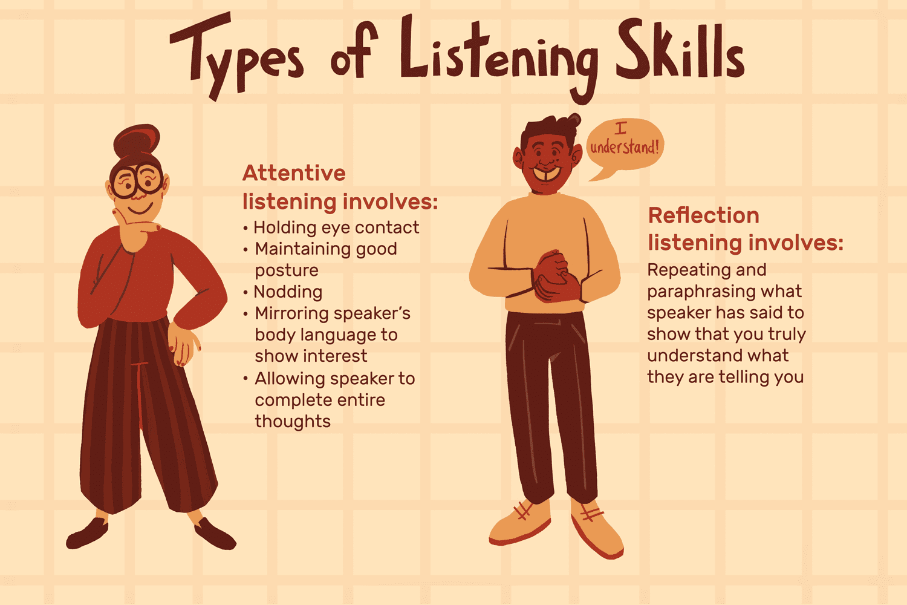
WHAT IS LISTENING?
& TYPES OF LISTENING

Slide 8
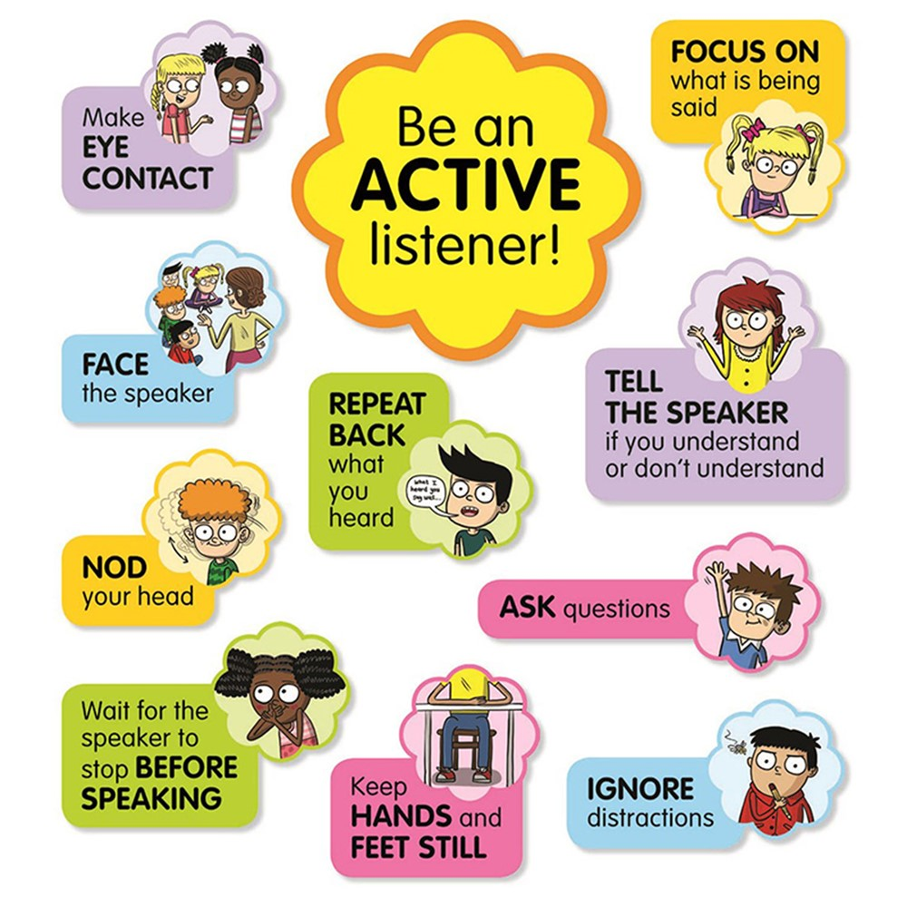
WHAT IS ACTIVE LISTENING

Slide 9
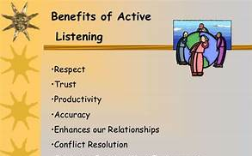
Benefits of Effective Listening

Slide 10
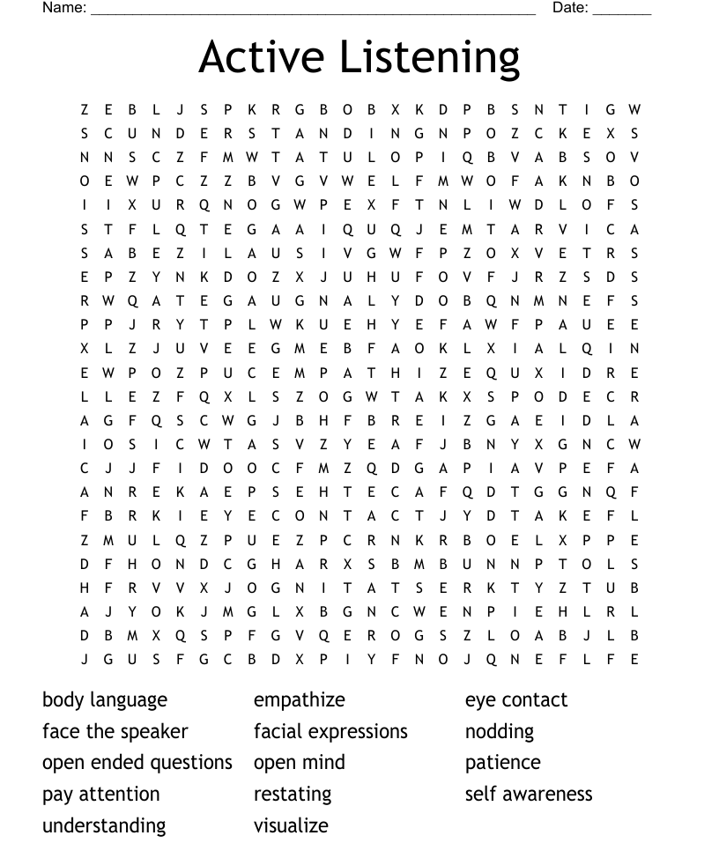
Notes:
ACTIVITY TIME

Slide 11

TAKE AWAY !
Impact of Absent Mindedness in listening
Importance of Active Mindedness in Listening
What is Listening and Its Types
What are the benefits of Effective Listening skills

Slide 12




